Slide 1
Object-Oriented Programming
WEEK 07 Abeeha Sattar

Slide 2
Inheritance in OOP
Sometimes, one class is an extension of another class
OR…
Sometimes, one class is derived from another class
ORRRRR…
Sometimes, one class is a child of another class?

Slide 3
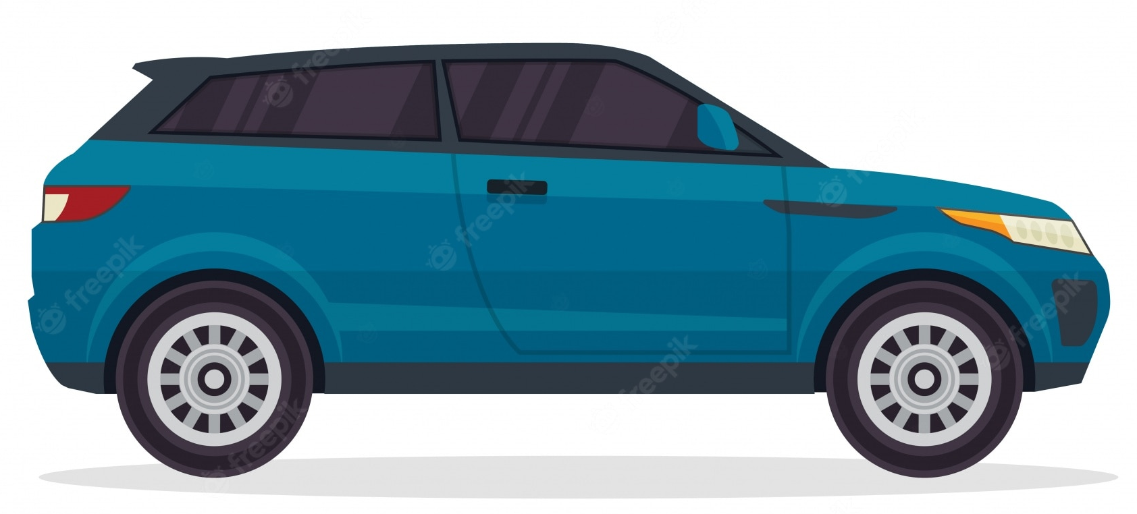
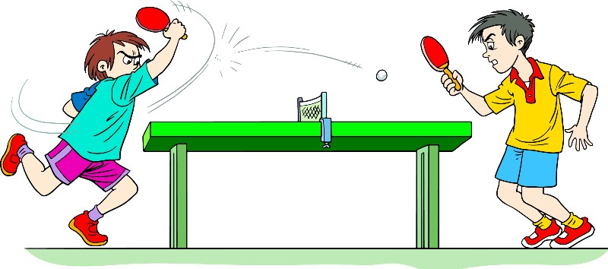

Examples
A car is-a vehicle
A truck is-a vehicle
Cricket is-a sport
Table Tennis is-a sport
Spider is-an arachnid
Scorpion is-an arachnid

Slide 4

More on Inheritance
The extended (or child) class contains all the features of its base (or parent) class, and may additionally have some unique features of its own.
In a class diagram, you use an arrow from child to parent class to show inheritance. The head of the arrow will be towards the parent.
Therefore, it allows us to derive properties from another class while programming, and saves a lot of effort that might be needed to rewrite the same code over and over!

Slide 5
Important Concepts/Terms
Super Class
Sub Class
The class whose attributes will be inherited by the derived class
You can call it any of the following:
A base class
A super class
A parent class
The class that inherits the properties from another class
You can call it any of the following:
A derived class
A sub class
A child class

Slide 6
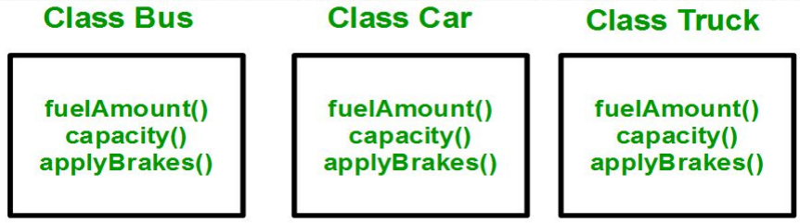
Where and when do we need Inheritance?
Consider a group of vehicles. You need to create classes for Bus, Car and Truck. The methods fuelAmount(), capacity(), applyBrakes() will be same for all of the three classes
Bus
Car
Truck
fuelAmount()
capacity()
applyBrakes()
BAD!!!!!!

Slide 7
Where and when do we need Inheritance?
Why is, what we saw earlier, bad?
Duplication of code
What’s wrong with that?
Increase in lines of code
More code = more chances for error
Redundant Code =
Not reusing code =
Redundant Code…
oh…
wait…

Slide 8
How to solve the issue?
You may have noticed that car, bus and truck can be categorized as vehicles
We can create a Vehicle class, then,
Add the three common methods to the class
Inherit each of the classes from the Vehicle class
Viola! Reusable code without any redundancy!!

Slide 9
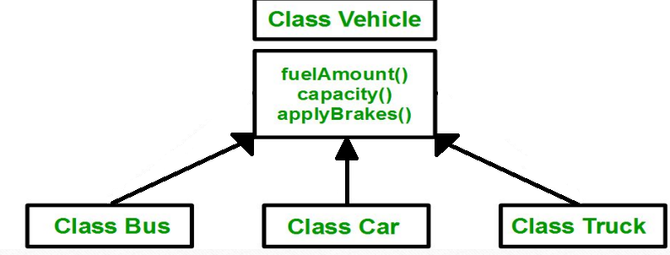
Solution: (Partial Class Diagram)

Slide 10
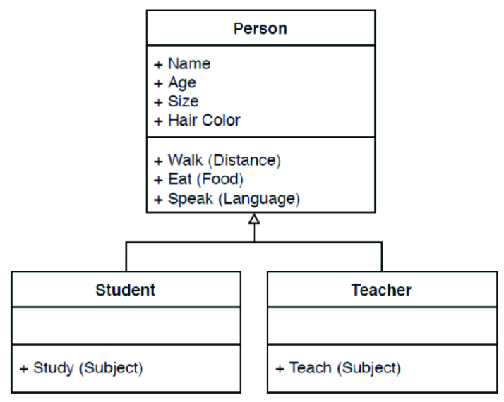
Class Diagram showing Inheritance

Slide 11
Inheritance Implementation in C++
You have to use the following syntax in order to implement inheritance in your C++ code:
class subclass_name : access_mode base_class_name
{
//body of subclass
};

Slide 12
Coding our Vehicle Example (pt. 1)
class Vehicle {
public:
void fuelAmount() {
cout << "Filled 5 liters." << endl;
}
void capacity() {
cout << "Capacity is 10 liters." << endl;
}
void applyBrakes() {
cout << "Brakes Applied." << endl;
}
};
class Bus : public Vehicle {};
class Car : public Vehicle{};
class Truck : public Vehicle {};

Slide 13
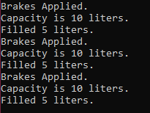
Coding our Vehicle Example (pt. 2)
int main()
{
Bus b;
Car c;
Truck t;
b.applyBrakes();
b.capacity();
b.fuelAmount();
c.applyBrakes();
c.capacity();
c.fuelAmount();
t.applyBrakes();
t.capacity();
t.fuelAmount();
}

Slide 14
Access Modes of Inheritance
These are supposed to define how we want to inherit the parent class as;
Public
Protected
Private

Slide 15
Public Mode
If we derive a sub class from a public base class:
The public members of the base class will become public in the derived class
The protected members of the base class will remain protected in derived class.
The private members of the base class cannot be accessed by the child class directly, so it has no impact on the private members.

Slide 16
Protected Mode
If we derive a sub class from a protected base class:
The public members of the base class will become protected in the derived class
The protected members of the base class will remain protected in derived class.
The private members of the base class cannot be accessed by the child class directly, so it has no impact on the private members.

Slide 17
Private Mode
If we derive a sub class from a private base class:
The public members of the base class will become private in the derived class
The protected members of the base class will become private in derived class.
The private members of the base class cannot be accessed by the child class directly, so it has no impact on the private members.

Slide 18
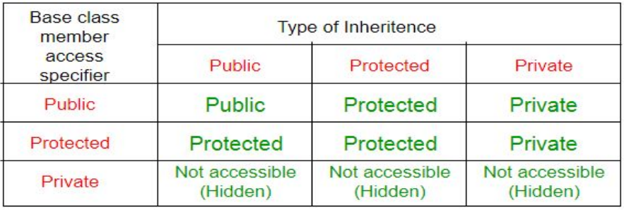
Modes of Inheritance

Slide 19
Fin.
: 3

